Slide 1

Team 13
Leader – alexander nguyen

Slide 2


Slide 3
Property Hub Website
LOADING….

Slide 4
OVERVIEW
We have created a startup idea with the desire to bring property buyers and property sellers into a single platform.
Our plan was to build a fully functional website that had the following functionalities:
Homepage
user signup/ login
seller dashboard

Slide 5

Key Features
Sign-up/ Login:
The user is asked to sign-up and then login to play the game.

Slide 6
Key Features
Registration/ Login : Handles the registration and login of all users; Prompts user to sign up as either admin/seller/buyer, if they’re a new user, and redirects them to the login page once registered.

Slide 7
Key Features
Registration/ Login : Handles the registration and login of all users; Prompts user to sign up as either admin/seller/buyer, if they’re a new user, and redirects them to the login page once registered.
Seller dashboard: lists all property details. (E.g. , location, age, # of bedrooms)

Slide 8
Key Features
Registration/ Login : Handles the registration and login of all users; Prompts user to sign up as either admin/seller/buyer, if they’re a new user, and redirects them to the login page once registered.
Seller dashboard: lists all property details. (E.g. , location, age, # of bedrooms)
Add property: to register/add a new property to the platform

Slide 9
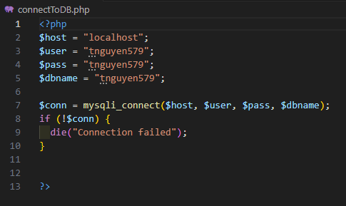
CODE SNIPPETS – CONNECT TO DB

Slide 10
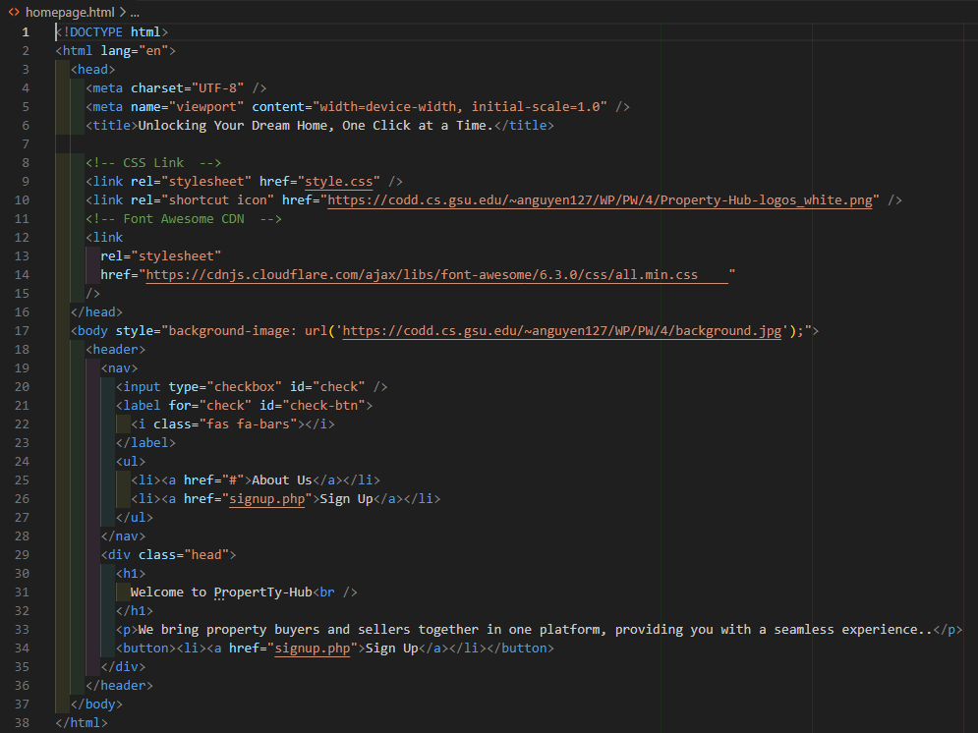
CODE SNIPPETS – HOMEPAGE

Slide 11
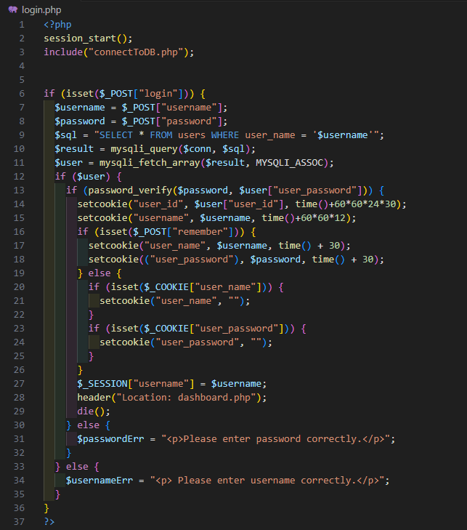
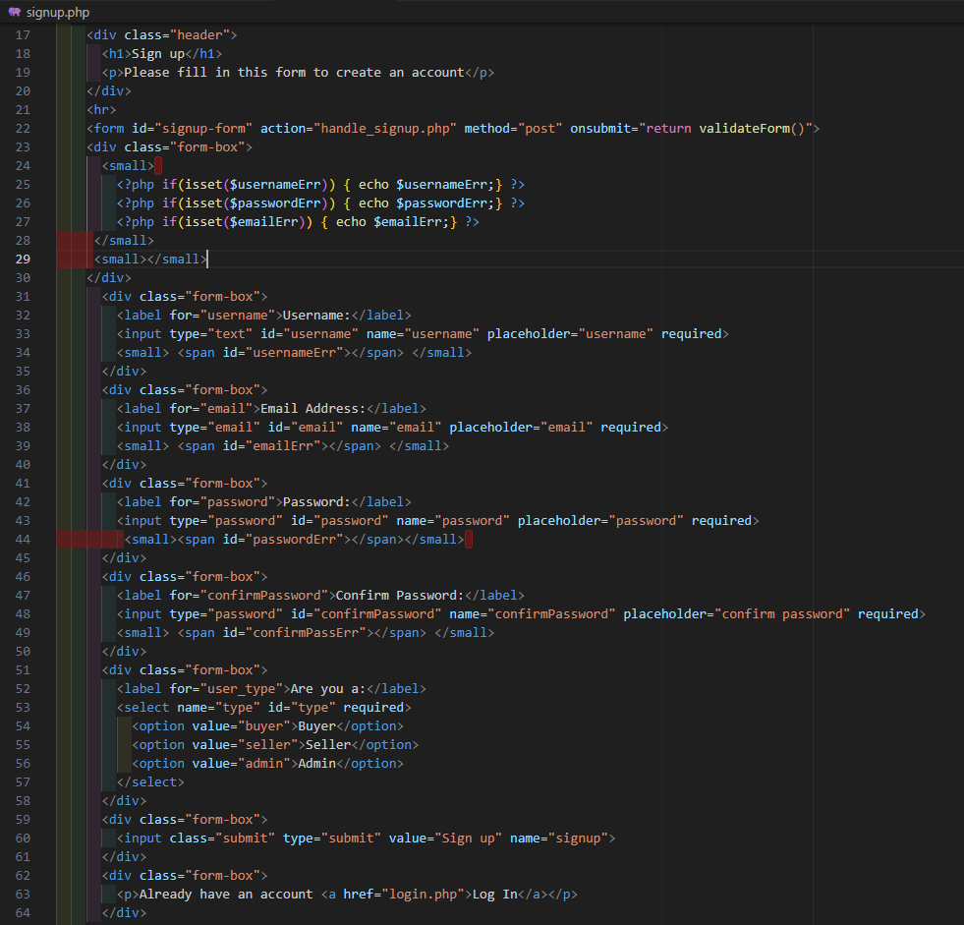
CODE SNIPPETS – SIGNUP/LOGIN

Slide 12
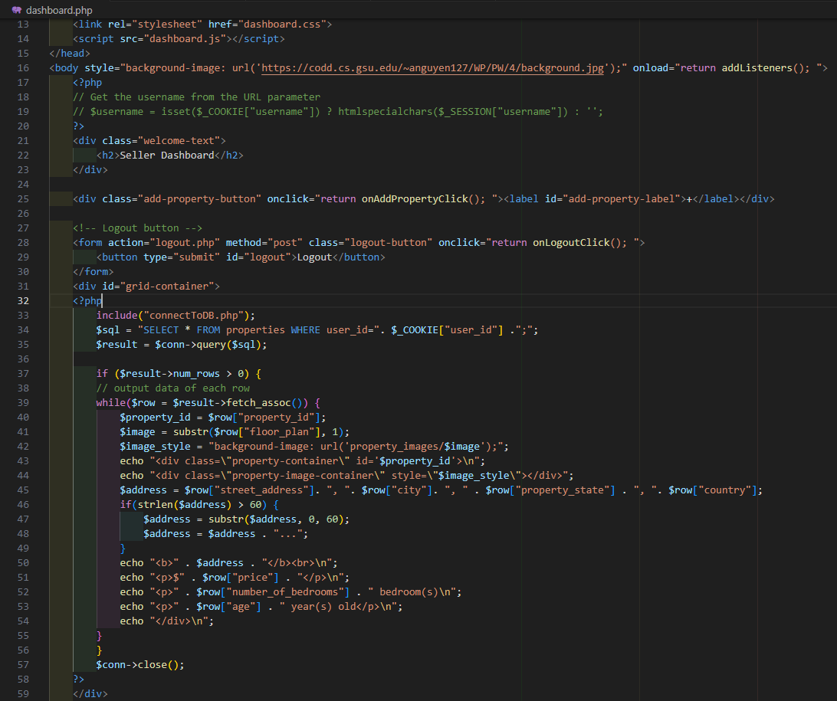
CODE SNIPPETS - DASHBOARD

Slide 13
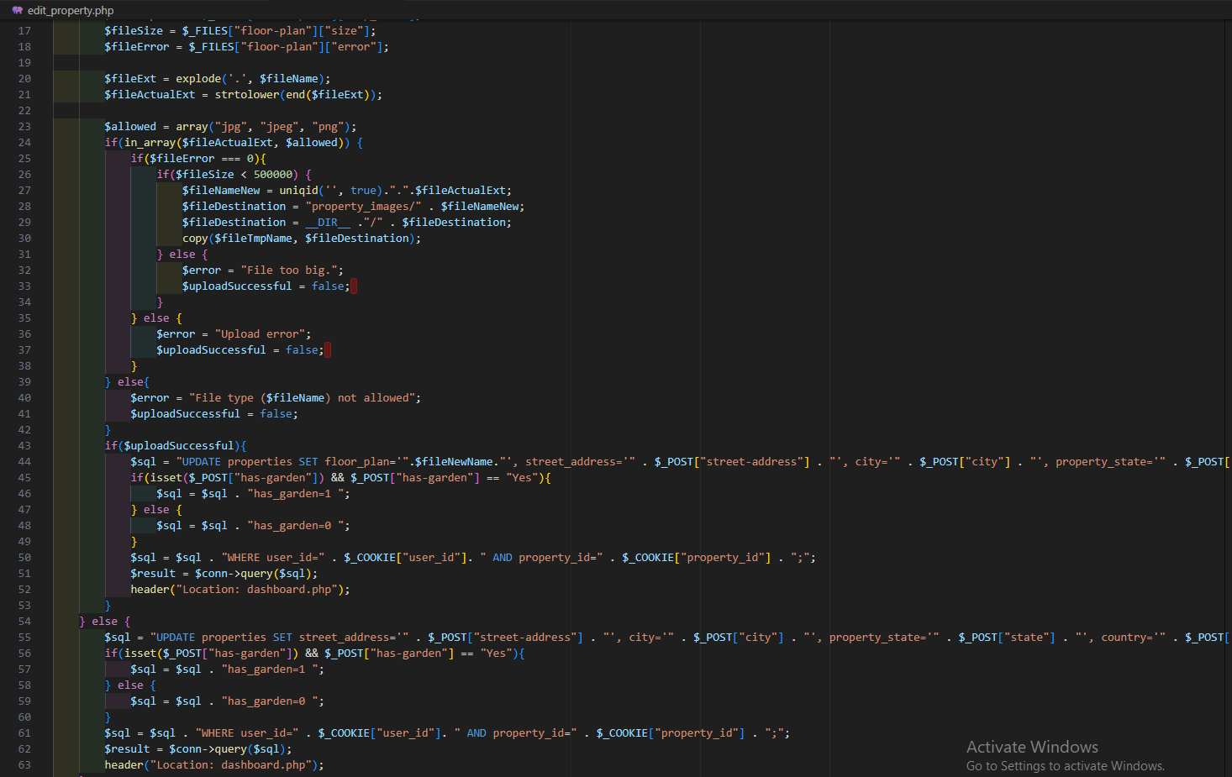
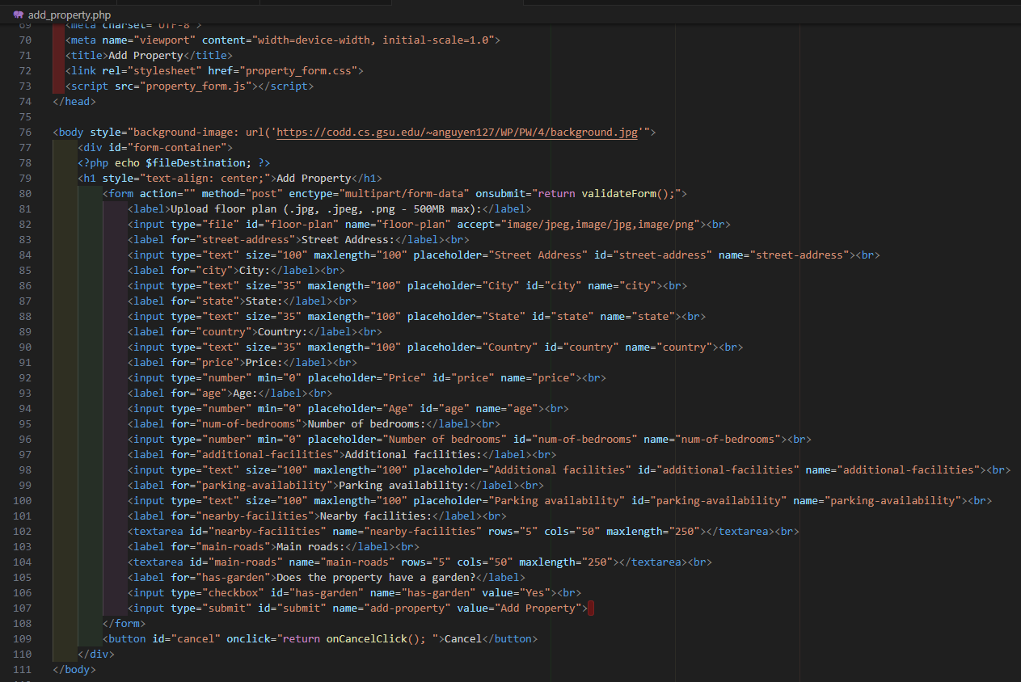
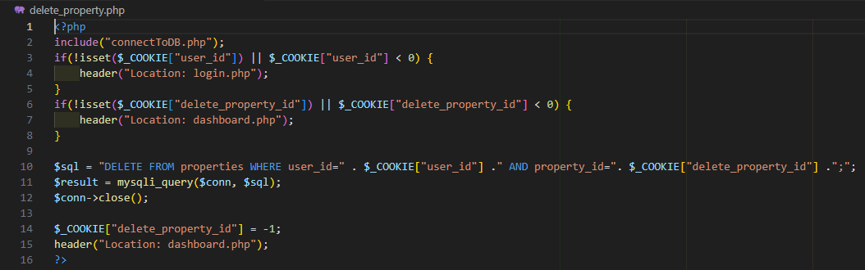
CODE SNIPPETS – ADD/EDIT/DELETE PROPERTY

Slide 14
DEMO
Project Link:
https://codd.cs.gsu.edu/~anguyen127/WP/PW/4/homepage.html

Slide 15
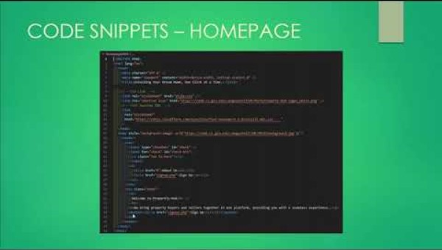
Demo Run

Slide 16
Summary

Slide 17
Summary
Our innovative startup, Property-Hub, is a company website that was built utilizing HTML, Javascript, PHP, and CSS. Its features include a homepage, a signup/login page, and a seller dashboard. It works to bring property buyers and property sellers under a single platform.

Slide 18
THE SCRUM METHODOLOGY
Effective organizational method
Allows for a common space for team to communicate and hold each other accountable
Promotes efficient project planning
Process is streamlined for efficient delivery
Keeps the team up-to-date on the progress of the project

Slide 19


